Slide 1
Employee Management System
Efficiently managing employee data and operations.

Slide 2
Introduction
This presentation outlines the functions and features of the Employee Management System, focusing on adding, displaying, and managing employee records.

Slide 3

01
Employee Management

Slide 4
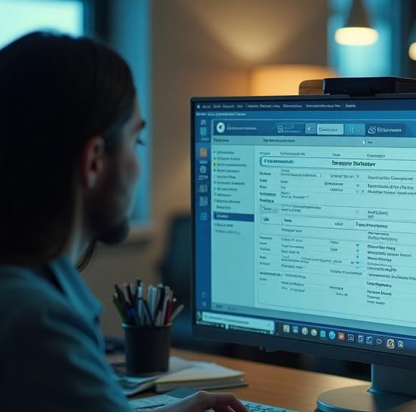
Adding Employees
The system allows for the seamless addition of new employees by capturing essential information such as ID, name, department, and salary. This process includes input validation to ensure data integrity and successful entry feedback to the user.

Slide 5
Displaying Employees
Employees added to the system can be displayed in a structured format, showcasing IDs, names, departments, and salaries. This feature allows for quick access to employee information and helps in maintaining transparency in workforce management.

Slide 6
Searching and Deleting Employees
The system offers functionalities to search for employees by their ID and display relevant information. If the employee is found, the user has the option to delete their record, which includes shifting the array of employee records to maintain order. Appropriate feedback is provided to inform the user of success or failure in these operations.

Slide 7

02
Employee Information

Slide 8
Employee Details
Each employee's record contains vital information such as ID, name, department, and salary. Accessing these details is crucial for management to monitor employment status and ensure transparency within the organization.

Slide 9

Updating Employee Data
The system enables easy updates to employee information. Users can modify details like name, department, and salary. This function is crucial for maintaining accurate records throughout an employee's tenure.

Slide 10
Storing Employee Records
Employee records are stored in a global array that can house up to 100 employees. This setup allows quick retrieval and manipulation of data, supporting organizational needs in real-time.

Slide 11

Conclusions
The Employee Management System streamlines the process of managing employee data, ensuring efficient operations in adding, displaying, updating, and deleting records. Maintaining accurate and up-to-date employee information is vital for effective human resources management.

Slide 12
Thank you!
Do you have any questions?
+00 000 000 000

